Slide 1

CS 4417/5517
Minhaz F. Zibran
Idaho State University

Slide 2

2020 Reported Russian Hacking Attacks
I believe that we are more susceptible to misinformation and ideological attacks because of the global Covid-19 health crisis, conflicting information about voting by mail, and chiefly because of how polarized, tribal, and generally intolerant we (USA) have become of each other as a society.
- Alexander Urbelis

Slide 3
SOW for the Week: complete the followings
By Wednesday evening
  Read Cyber Intelligence Handbook Section 4.3 and 4.4 (i.e., pp. 215-258)
  Review the OODA guide
  Read the news article, “Six Russian GRU Officers Charged in Connection with Worldwide Deployment of Destructive Malware and Other Disruptive Actions in Cyberspace”
  Read the article, “The Untold Story of NotPetya, the Most Devastating Cyberattack in History”
  Read the report on “US Indictment for Alleged Russian Hacking Efforts US Case 20-316”
  Watch the Session 12 Narrated Powerpoint
By Sunday evening
  Complete the Week 12 Quiz

Slide 4
Overview of Weekly Learning Effort
Statement of Work (SOW) – Readings and Posed Questions
5 +/-2 major concepts or models
Review
Reminder for weekly quiz
  Note for essay questions, You should have an introductory thesis statement 3 to 7 supporting evidentiary sentences and a conclusion sentence. – Show your critical thinking

Slide 5
Concept 1- Section 4.3-4 Execution & Evaluation
  Execute Phase — page 215
  Continuous— page 215
  3 subtasks— page 215
  The execution phase encompasses all actions…. page 216
  All Source Analysis page 224
  Evaluation Phase

Slide 6
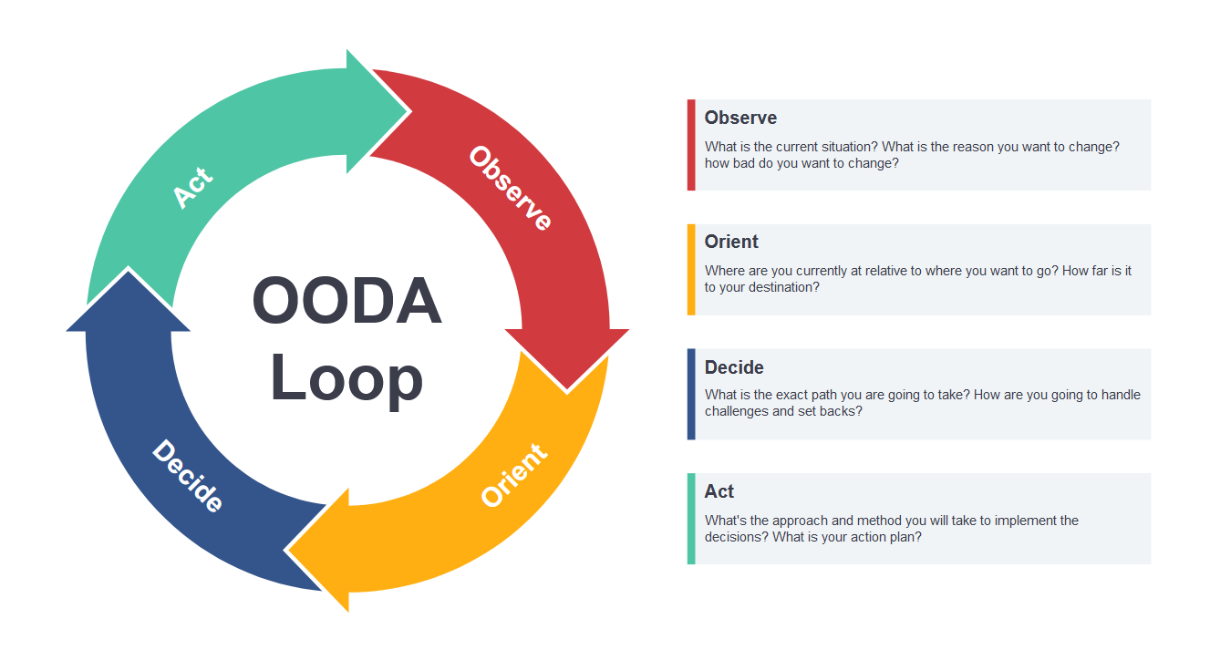
OODA Loop - A useful tool

Slide 7
The OODA Loop
(Observe, Orient, Decide, Act)
A four-step approach for both analysis and decision-making that focuses on filtering available information, putting it in context and quickly making the most appropriate decision while also understanding that changes can be made as more data becomes available.
The strategy is applicable at an individual level as well as an organizational level. It is particularly useful in scenarios where competition is involved and where the ability to react to changing circumstances faster than an opponent leads to an advantage.

Slide 8
The OODA Loop
(Observe, Orient, Decide, Act)
Many modern environments can be described as volatile, uncertain, complex and ambiguous, or VUCA. Surviving and winning in this type of situation rests upon making better decisions. However, improving the quality of decision-making is something most organizations fail to do. For example, if a company continues to make choices that do not see a positive return, they are failing to learn from their experiences. The OODA loop acknowledges this habit and provides an approach help make improvements.
Applied to a variety of fields, the OODA loop was developed in the mid-20th century by the military strategist, Colonel John Boyd. It was initially used to train solders to make time-sensitive decisions rapidly when there may not be time to gather all the information.
The goal of the strategy was to execute the OODA loop process more quickly than an opponent in order to infiltrate and disrupt the adversary’s decision cycle.
https://searchcio.techtarget.com/definition/OODA-loop

Slide 9
OODA CTI Template (7 slides)
Use this template to organize an OODA analysis
Introduce yourself and what topic you are presenting – i.e. OODA – US Russian Hacking Indictment (1) Informational OR (2) a Decision/Recommendation– maybe announce the USG level of security classification
Bottom Line Up Front (BLUF) – This an informational presentation IAW SOW
Observations – Limit these to The Magical Number Seven, Plus or Minus Two
Orientation – Limit these to The Magical Number Seven, Plus or Minus Two
Decisions – Limit these to The Magical Number Seven, Plus or Minus Two
Actions – Limit to one recommendation
Sources of information and/or intelligence – note about sources and methods (collection mechanisms)

Slide 10
OODA – Analysis Scenario
Situation — you're a newly hired cyber threat intelligence officer who has been assigned to work for a US government agency in Washington DC. You have initial analyst training and have been assigned to work in a section dealing with cyber threats.
Your supervisor Susan — comes your office and welcomes you to her cyber threat intelligence cell.
She starts — "I have an initial assignment for you to complete there is some unclassified open-source intelligence materials that I would like you to read and analyze, I want you to prepare a PowerPoint presentation for an information reaching using the OODA framework. I would like you to recommend one action that we need to consider in our cyber threat cell - for example do we need to focus additional collection resources on information contained in this material."

Slide 11
Class Assignment
Read the materials that have been posted on the weekly session plan. Reflectively consider the information, think about who, what, when, where and how - and prepare an OODA analysis.
Use Microsoft PowerPoint and narrate your OODA analysis and you will attach this to your weekly quiz when asked by a particular question you'll simply upload your analysis in response to the respective question.
Note that for this week’s quiz you will have three hours to complete the 12-question quiz. You may wish to start your OODA before the quiz opens.

Slide 12
Class Review
SOW for week was posed
Concepts – introduced these in relation to the syllabus and the assigned reading
Posed questions for reading and reflection – (in week’s quiz – numbers and time)
Weekly Quiz – complete this before next week class – everything in quizzes are open book, notes and is timed (3 hours).
Notice about the week’s quiz – ~ 12 random short responses and essay questions – some critical thinking - essay – plan your time – 3 hours
Acknowledgement: This slides are adapted based on the work of Dr. Larry Leibrock.

